Slide 1
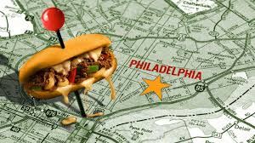
The Philly Food Project
Michael Andia | Blake Bartlett | Christopher Duke | Tim McCarthy | Krissina Wells
Project Description:
The Philadelphia Restaurant Cuisine project aims to visualize restaurant cuisines in Philadelphia. By leveraging data from Yelp and GeoJSON, this project provides interactive maps and other charts that highlight the top cuisines in the area, allowing users to explore the culinary landscape of the city.
Project Features:
Interactive map displaying the most common cuisines by zip code.
Mouseover tooltips providing detailed information on the top three cuisines for each area.
Color-coded legend for easy identification of cuisine types.
Zoom functionality for in-depth exploration of specific regions.

Slide 2
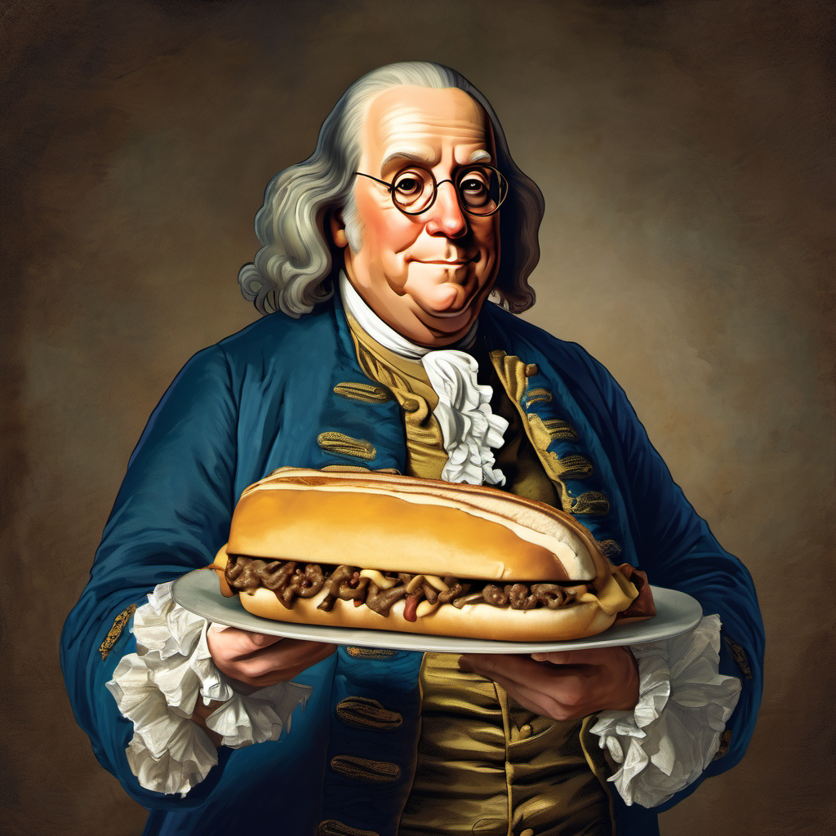
The Philly Food Project
Michael Andia | Blake Bartlett | Christopher Duke | Tim McCarthy | Krissina Wells
Project Features:
Interactive map displaying the most common cuisines by zip code.
Mouseover tooltips providing detailed information on the top three cuisines for each area.
Color-coded legend for easy identification of cuisine types.
Zoom functionality for in-depth exploration of specific regions.
Interacting With The Map:
Mouseover: Hover over different zip codes to see the top three cuisines in that area.
Zoom: Click on a zip code to zoom in and explore specific regions more closely.
Caveats:
The following zip codes showed no results in the dataset, meaning there are no restaurants listed in these areas: 19137, 19133, 19141, 19109.

